Slide 1
WEEK 2
Forward CDMA process, Reverse CDMA Process, Multicarrier modulation, OFDM
References:
William Stallings, "Wireless Communication & Networking", Pearson Education Asia, 2009
Rappaport.T.S, “Wireless Communications:Principles and Practice”

Slide 2
Code Division Multiple Access (CDMA)

Slide 3
Code Division Multiple Access
A digital cellular system based on CDMA which promises increased capacity and has been standardized as Interim Standard 95 (IS-95) by the U.S Telecommunications Industry Association (TIA).
IS-95 allows each user within a cell to use the same radio channel, and users in adjacent cells also use the same radio channel, since this is a direct sequence spread spectrum CDMA system .
The IS-95 system is designed to be compatible with the existing U.S. analog cellular system (AMPS) frequency band, hence mobiles and base stations can be economically produced for dual mode operation.
To facilitate graceful transition from AMPS to CDMA, each IS-95 channel occupies 1.25 MHz of spectrum on each one-way link.

Slide 4
CDMA(IS-95) Contd.
A pilot code is also transmitted simultaneously and at a higher power level, thereby allowing all mobiles to use coherent carrier detection while estimating the channel conditions.
On the reverse link, all mobiles respond in an asynchronous fashion and have ideally a constant signal level due to power control applied by the base station.
The speech coder used in the 15-95 system is the Qualcomm 9600 bps Code Excited Linear Predictive (QCELP) coder.
The original implementation of this vocoder detects voice activity, and reduces the data rate to 1200 bps during silent periods. Intermediate user data rates of 2400, 4800, and 9600 bps.

Slide 5
CDMA
Higher quality signals
Higher data rates
Support of digital services
Greater capacity
Digital traffic channels
Support digital data
Voice traffic digitized
User traffic (data or digitized voice) converted to analog signal for transmission
Encryption
Simple to encrypt digital traffic
Error detection and correction
Very clear voice reception
Channel access
Channel dynamically shared by users via Time division multiple access (TDMA) or code division multiple access (CDMA)

Slide 6
Code Division Multiple Access
Advantages
Frequency diversity
Frequency-dependent transmission impairments (noise bursts, selective fading) have less effect
Multipath resistance
DSSS overcomes multipath fading by frequency diversity
Also, chipping codes used only exhibit low cross correlation and low autocorrelation
Version of signal delayed more than one chip interval does not interfere with the dominant signal as much
Privacy
From spread spectrum
Disadvantages
Graceful degradation
With FDMA or TDMA, fixed number of users can access system simultaneously
With CDMA, as more users access the system simultaneously, noise level and hence error rate increases
Gradually system degrades

Slide 7
Code Division Multiple Access
Self-jamming
Unless all mobile users are perfectly synchronized, arriving transmissions from multiple users will not be perfectly aligned on chip boundaries
Spreading sequences of different users not orthogonal
Some cross correlation
Distinct from either TDMA or FDMA
In which, for reasonable time or frequency guard bands, respectively, received signals are orthogonal or nearly so
Near-far problem
Signals closer to receiver are received with less attenuation than signals farther away
Given lack of complete orthogonality, transmissions from more remote mobile units may be more difficult to recover

Slide 8
Frequency and Channel Specifications
Reverse link operation in the 824 - 849 MHz band and 869 - 894 MHz for the forward link.
A forward and reverse channel pair is separate by 45 MHz. Many users share a common channel for transmission.
The maximum user data rate is 9.6 kb/s. User data in IS-95 is spread to a channel chip rate of 1.2288 Mchip/s (a total spreading factor of 128) using a combination of techniques.
The spreading process is different for the forward and reverse links.

Slide 9
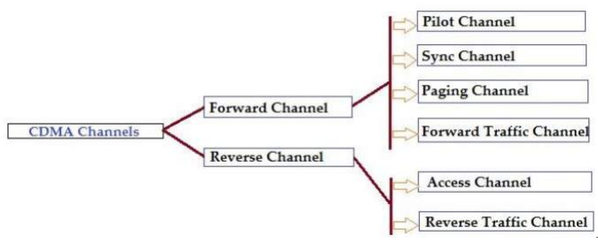
CDMA

Slide 10
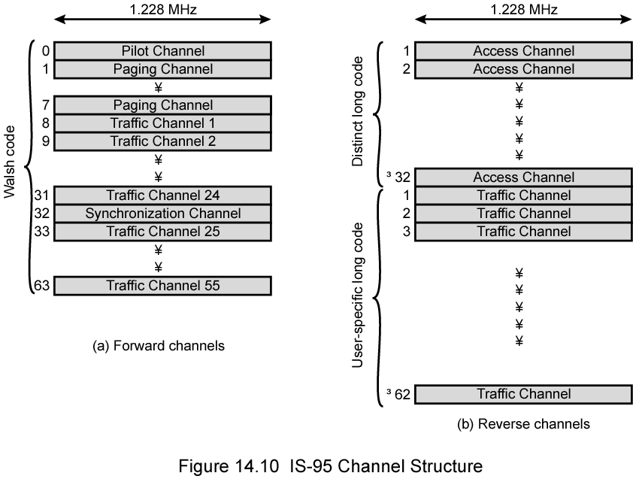
IS-95 Channel Structure

Slide 11
Forward Link
On the forward link, the user data stream is encoded using a rate 1/2 convolutional code, interleaved, and spread by one of sixty-four orthogonal spreading sequences (Walsh functions).
To reduce interference between mobiles that use the same spreading sequence in different cells, and to provide the desired wideband spectral characteristics all signals in a particular cell are scrambled using a pseudorandom sequence of length 2 ¹⁵ chips.
Orthogonality among all forward channel users within a cell is preserved because their signals are scrambled synchronously.
A pilot channel (code) is provided on the forward link so that each subscriber within the cell can determine and react to the channel characteristics while employing coherent detection.

Slide 12
Reverse Link
On the reverse link, a different spreading strategy is used since each received signal arrives at the base station via a different propagation path.
The reverse channel user data stream is first convolutionally encoded with a rate 1/3.
After interleaving, each block of six encoded symbols is mapped to one of the 64 orthogonal Walsh functions, providing sixty-four-ary orthogonal signaling.
A final four fold spreading, giving a rate of 1.2288 Mchip/s, is achieved by spreading the resulting 307.2 kchip/s stream by user-specific and base-station specific codes having periods of 2 ⁴² – 1 chips and 2 ¹⁵ chips are used.
The rate 1/3 coding and the mapping onto Walsh functions result in a greater tolerance for interference.
This added robustness is important on the reverse link, due to the non coherent detection and the in-cell interference received at the base station. Another element is tight control of each subscriber's transmitter power, to avoid the "near-far" problem that arises from varying received powers of the users.

Slide 13
IS-95 Forward Link (1)
Up to 64 logical CDMA channels each occupying the same 1228-kHz bandwidth
Four types of channels:
Pilot (channel 0)
Continuous signal on a single channel
Allows mobile unit to acquire timing information
Provides phase reference for demodulation process
Provides signal strength comparison for handoff determination
Consists of all zeros
Synchronization (channel 32)
1200-bps channel used by mobile station to obtain identification information about the cellular system
System time, long code state, protocol revision, etc.

Slide 14
IS-95 Forward Link (2)
Paging (channels 1 to 7)
Contain messages for one or more mobile stations
Traffic (channels 8 to 31 and 33 to 63)
55 traffic channels
Original specification supported data rates of up to 9600 bps
Revision added rates up to 14,400 bps
All channels use same bandwidth
Chipping code distinguishes among channels
Chipping codes are the 64 orthogonal 64-bit codes derived from 64 × 64 Walsh matrix

Slide 15
Forward Link Processing
Voice traffic encoded at 8550 bps
Additional bits added for error detection
Rate now 9600 bps
Full capacity not used when user not speaking
Quiet period data rate as low as 1200 bps
2400 bps rate used to transmit transients in background noise
4800 bps rate to mix digitized speech and signaling data
Data transmitted in 20 ms blocks
Forward error correction
Convolutional encoder with rate ½
Doubling effective data rate to 19.2 kbps
For lower data rates encoder output bits (called code symbols) replicated to yield 19.2-kbps
Data interleaved in blocks to reduce effects of errors by spreading them

Slide 16
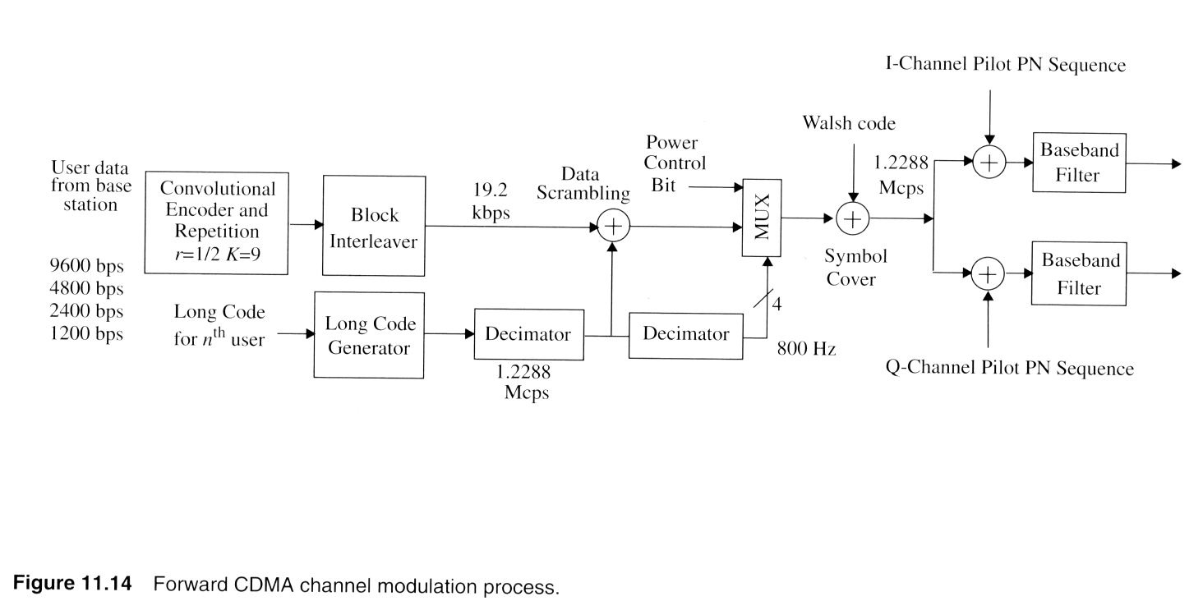
CDMA- Forward channel
Notes:
Fig. 2.11

Slide 17
CDMA- Forward channel
Consists of a pilot channel, a synchronization channel, up to seven paging channels, and up to sixty-three forward traffic channels.
The pilot channel allows a mobile station to acquire timing for the Forward CDMA channel, provides a phase reference for coherent demodulation,
and provides each mobile with a means for signal strength comparisons between base stations for determining when to handoff.
The synchronization channel broadcasts synchronization messages to the mobile stations and operates at 1200 bps.
The paging channel is used to send control information and paging messages from the base station to the mobiles and operates at 9600, 4800, and 2400 bps.
The forward traffic channel supports variable user data rates at 9600,
4800, 2400, or 1200 bps. Data on the forward traffic channel is grouped into 20 ms frames.

Slide 18
CDMA- Forward channel
Data on the forward traffic channel is grouped into 20 ms frames.
The user data is first convolutionally coded and then formatted and interleaved to adjust for the actual user data rate, which may vary.
Then the signal is spread with a Walsh code and a long PN sequence at a rate of 1.2288 Mcps.
The speech data rate applied to the transmitter is variable over the range of
1200 bps to 9600 bps.

Slide 19
Convolutional Encoder and Repetition Circuit
Speech coded voice or user data are encoded using a half-rate convolutional encoder with constraint length 9. The encoding process is described by generator vectors and G1 which are 753 (octal) and 561 (octal).
The speech encoder exploits pauses and gaps in speech, and reduces its output from 9600 bps to 1200 bps during silent periods.
In order to keep a constant baseband symbol rate of 19.2 kbps, whenever the user rate is less than 9600 bps, each symbol from the convolution encoder is repeated before block interleaving.
Block Interleaver
After convolution coding and repetition, symbols are sent to a 20ms block interleaver , which is a 24 by 16 array.

Slide 20
Long PN Sequence
In the forward channel, direct sequence is used for data scrambling.
uniquely assigned to each user is a periodic long code with period 2 ⁴² -1 chips
Each PN chip of the long code is generated by the modulo-2 inner product of a 42 bit mask and the 42 bit state vector of the sequence generator.
The initial state of the generator is defined to be when the output of the generator becomes '1' after following 41 consecutive '0' outputs, with the binary mask consisting of '1' in the most significant bit (MSB) followed by 41 '0's.
Two types of masks are used in the long code generator: a public mask for the mobile station's electronic serial number (ESN) and a private mask for the mobile station identification number (MIN).
All CDMA calls are initiated using the public mask.
Transition to the private mask is carried out after authentication is performed.

Slide 21
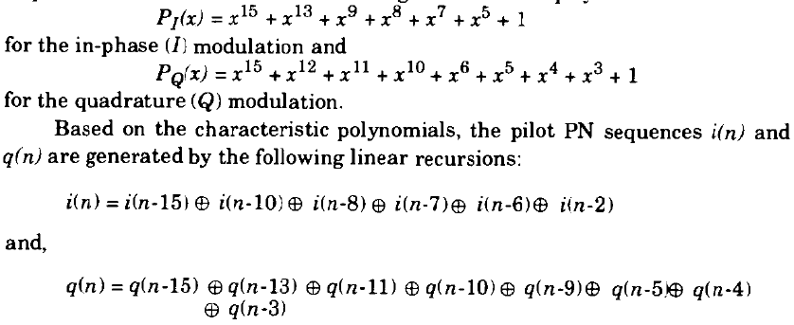
Characteristic Polynomials
The long code is specified by the following characteristic polynomial is given below
This short spreading sequence is called the pilot PNsequence, and it is based on the following characteristic polynomials used in Quadrature Modulation

Slide 22
Data Scrambling
After Block interleaver, data is scrambled.
Privacy mask
Prevent sending of repetitive patterns
Reduces probability of users sending at peak power at same time.
Scrambling done by long code
Pseudorandom number generated from 42-bit-long shift register
Shift register initialized with user's electronic serial number
Output of long code generator is at a rate of 1.2288 Mbps
64 times 19.2 kbps
One bit in 64 selected (by the decimator function)
Resulting stream XOR ed with output of block interleaver

Slide 23
Power Control
To minimize the average BER for each user, IS-95 strives to force each user
to provide the same power level at the base station receiver.
both the signal and interference are continually varying, power control updates are sent by the base station every 1.25 ms.
Power control commands are sent to each subscriber unit on the forward control subchannel which instruct the mobile to raise or lower its transmitted power in 1 dB steps.
Power control bits are transmitted by using puncturing techniques.
During a 1.25 ms period, twenty-four data symbols are transmitted, and IS-95 specifies sixteen possible power control group positions for the power control bit.
Each position corresponds to one of the first sixteen modulation symbols.
Twenty-four bits from the long code decimator are used for data scrambling in a period of 1.25 ms

Slide 24
Orthogonal Covering
Each traffic channel transmitted on the forward CDMA channel is spread with a Walsh function at a fixed chip rate of 1.2288 Mcps.
The Walsh functions comprise of sixty-four binary sequences, each of length 64, which are completely orthogonal to each other and provide orthogonal channelization for all users on the forward link.
The Walsh functions comprise of sixty-four binary sequences, each of length 64, which are completely orthogonal to each other and provide orthogonal channelization for all users on the forward link.
A user that is spread using Walsh function n is assigned channel number n (n = 0 to 63).
The Walsh sequence repeats every 52.083 µs, which is equal to one coded data symbol. In other words, each data symbol is spread by 64 Walsh chips.

Slide 25
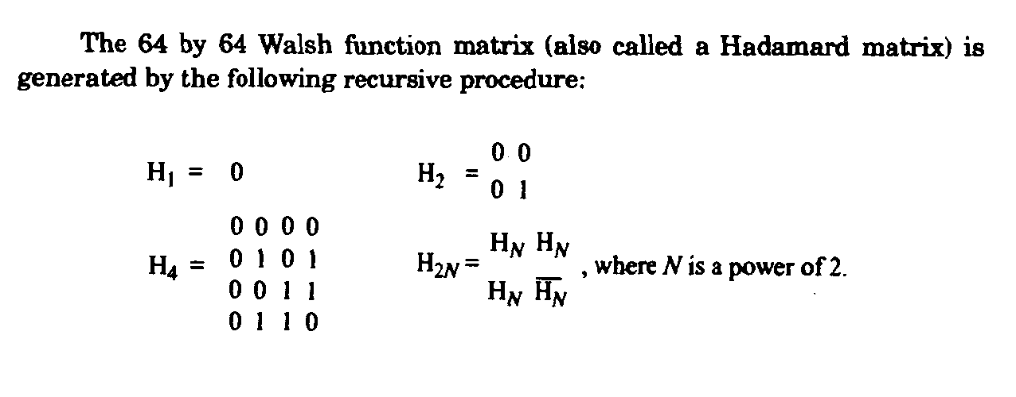
Walsh Hadamard Matrix

Slide 26
Quadrature Modulation
After the orthogonal covering, symbols are spread in quadrature.
A short binary spreading sequence, with a period of chips, is used for easy acquisition and synchronization at each mobile receiver and is
used for modulation.
This short spreading sequence is called the pilot PN sequence, and it is based on the characteristic polynomials P _{I} & P _{Q}
Based on the characteristic polynomials, the pilot PN sequences i(n) and
q(n) are generated by linear recursions.
The initial state of both land Q pilot PN sequences is defined as the state in
which the output of the pilot PN sequence generator is the first '1' output
following fifteen consecutive '0' outputs.
The chip rates for the pilot PN sequences are 1.2288 Mcps. The binary I and Q outputs of the quadrature spreading are mapped into phase accordingly.

Slide 27
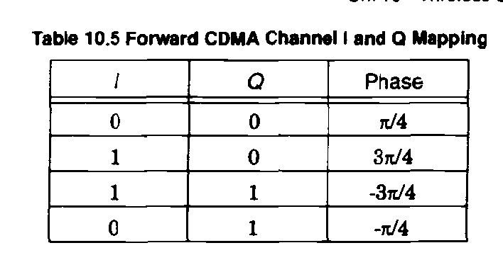
CDMA I and Q Mapping

Slide 28
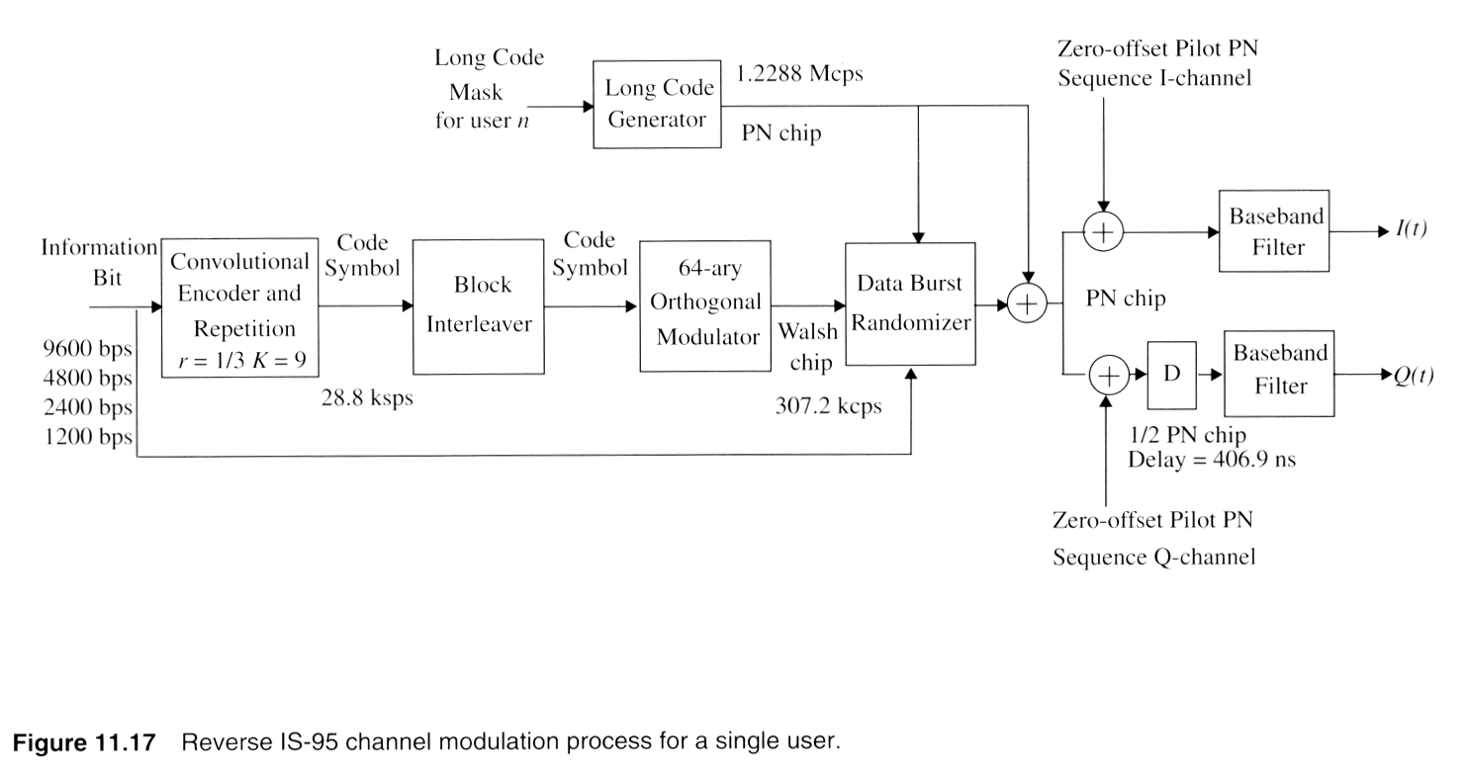
CDMA-Reverse Channel
Notes:
Fig. 2.9

Slide 29
CDMA-Reverse Channel
User data on the reverse channel are grouped into 20 ms frames.
All data transmitted on the reverse channel are convolutionally encoded, block interleaved, modulated by a 64-ary orthogonal modulation, and spread prior to transmission.
The speech or user data rate in the reverse channel may be sent at 9600, 4800, 2400, or 1200 bps.
The reverse CDMA channels are made up of access channels (AC) and reverse traffic channels (RTC).
Both share the same frequency assignment, and each Traffic/Access channel is identified by a distinct user long code.
The Reverse CDMA channel may contain a maximum of 32 ACs per supported paging channel. While the RTC operates on a variable data rate, the AC works at a fixed data rate of 4800 bps.

Slide 30
Reverse Link Processing
Convolutional Encoder and Symbol Repetition
The convolutional coder used in the reverse traffic channel is rate 1/3 and
constraint length 9.
The three generator vectors g0, g1, and g2 are 557 (octal), 663 (octal), and 771 (octal), respectively.
Coded bits after the convolutional encoder are repeated before interleaving
when the data rate is less than 9600 bps. This is identical to the method used on
the forward channel.
After repetition, the symbol rate out of the coder is fixed at 28,800 bps.
Block interleaver
performed following convolutional encoding and repetition.
The block interleaver spans 20 ms, and is an array with 32 rows and 18 columns.

Slide 31
Reverse Link Processing-Contd.
Orthogonal Modulation:
A 64-ary orthogonal modulation is used for the reverse CDMA channel.
One of sixty-four possible Walsh functions is transmitted for each group of six coded bits.
Within a Walsh function, sixty-four Walsh chips are transmitted.
Walsh function is selected according to the following formula:
Walsh function number = c ₀ + 2c ₁+ 4c ₂ + 5c ₃ + 16c ₄ + 32c ₅,
where c₅ represents the last coded bit and c₀ represents the first coded bit of each group of six coded symbols that are used to select a Walsh function. Walsh chips are transmitted at a rate of 307.2 kcps
28.8 kbps x (64 Walsh chips) / (6 coded bits) = 307.2 kbps
Walsh functions are used for different purposes on the forward and reverse channels. On the forward channel, Walsh functions are used for spreading
to denote a particular user channel, while on the reverse channel, Walsh
functions are used for data modulation.

Slide 32
Data Burst Randomizer
Reduce interference from other mobile stations
Using long code mask to smooth data out over 20 ms frame
The data burst randomizer generates a masking pattern 0’'s and 1’s that randomly masks the redundant data generated by the code repetition process.
A block of 14 bits taken from the long code determines the masking pattern.
The last 14 bits of the long code used for spreading in the second to last power control group of the previous frame are used to determine the random mask for the gating.

Slide 33
Direct Sequence Spreading
Long code unique to mobile XOR ed with output of randomizer
1.2288-Mbps final data stream
Modulated using orthogonal QPSK modulation scheme
Differs from forward channel in use of delay element in modulator to produce orthogonality
Forward channel, spreading codes orthogonal
Coming from Walsh matrix.
Each Walsh chip is spread by four long code PN chips.
Reverse channel orthogonality of spreading codes not guaranteed.

Slide 34
Quadrature Modulation
Prior to transmission, the reverse traffic channel is spread by I and Q channel
pilot PN sequences which are identical to those used in the forward CDMA channel process. These pilot sequences are used for synchronization purpose.
The reverse link modulation is offset quadrature phase shift keying (OQPSK).
The data spread by the Q pilot PN sequence is delayed by half a chip (406.901 ns) with respect to the data spread by the I pilot PM sequence.
This delay is used for improved spectral shaping and synchronization

Slide 35
Review Questions
How are different channels within the forward link in an IS-95 system identified?
Ans- using Walsh code

Slide 36
Orthogonal Frequency Divison Multiplexing
(OFDM)

Slide 37
MULTI CARRIER MODULATION (MCM)
Multipath propagation, time domain spreading of a signal, ISI occurs
Frequency selective fading, distortion, signal detection becomes
difficult
MCM converts a frequency selective fading into flat fading channel
Flat fading makes signal detection easier
MCM easily removes ISI
MCM transmits data over several carrier frequencies simultaneously
Each sub-stream modulates different carrier frequency
Parallel conversion lowers the data rate & bandwidth in each stream

Slide 38
OPERATION OF MCM
PSK or QAM modulation scheme is used
Signals from each data stream are summed together to form the transmitted signal
No change in original data rate & system bandwidth, but ISI is
eliminated
MCM needs larger bandwidth, spectrally inefficient
Multiple carriers and multiple oscillators increases the BW
OFDM is a special case of MCM, which addresses all the above issues

Slide 39
OFDM CONCEPT
System bandwidth is divided into a set of parallel overlapping, yet
orthogonal sub-bands independent to each other
Data is first split into independent streams, which modulate different sub-carriers
Then are multiplexed to create OFDM signal
OFDM is a special case of FDM
Significantly improves spectral efficiency
Avoid the need for steep band pass filters
Avoids the need of a bank of oscillators, since can be implanted digitally

Slide 40
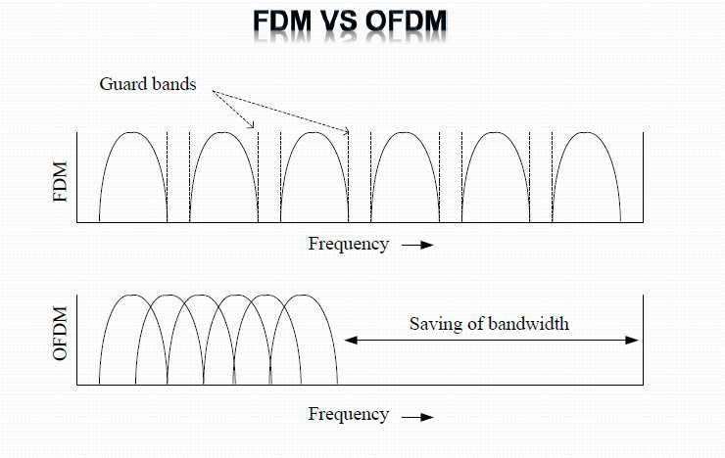

Slide 41
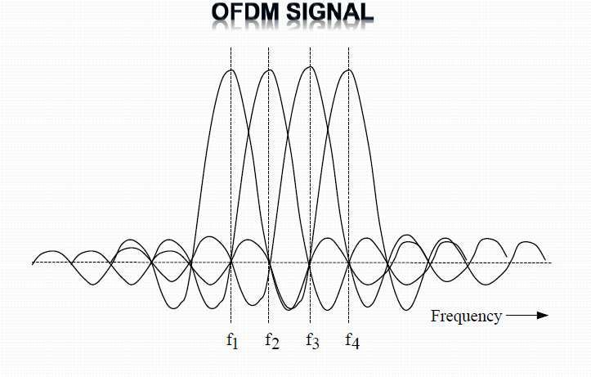

Slide 42
OFDM ADVANTAGES
Permits densely packed & overlapping sub-carriers
Offers spectrally efficient transmission scheme
Can be digitally implemented using, fast & efficient signal processing
Permits flexible use of spectrum
Supports different modulation schemes based on channel conditions
Almost completely avoids the need for an equalizer

